Slide 1
Partial Order Planning

Slide 2
The Planning Problem
Formally a planning algorithm has three inputs:
A description of the world in some formal language,
A description of the agent’s goal in some formal language, and
A description of the possible actions that can be performed.
The planner’s o/p is a sequence of actions which when executed in any world satisfying the initial state description will achieve the goal.

Slide 3
Representation for states and goals
In the STRIPS language, states are represented by conjunctions of function-free ground literals, that is, predicates applied to constant symbols, possibly negated. For example,
At(Home)^ ¬ Have(Milk)^ ¬ Have(Bananas)^ ¬ Have(Drill)^….
Goals are also described by conjunctions of literals. For example,
At(Home)^Have(Milk)^ Have(Bananas)^ Have(Drill)
Goals can also contain variables. For example, the goal of being at a store that sells milk would be represented as

Slide 4
Representations for actions
Our STRIPS operators consist of three components:
the action description is what an agent actually returns to the environment in order to do something.
the precondition is a conjunction of atoms (positive literals) that says what must be true before the operator can be applied.
the effect of an operator is a conjunction of literals (positive or negative) that describes how the situation changes when the operator is applied.
Here’s an example for the operator for going from one place to another:
Op(Action:Go(there), Precond:At(here)^Path(here, there), Effect:At(there)^ ¬At(here))

Slide 5
Search through World Space
The simplest way to build a planner is to cast the planning problem as search through the space of world states. Each node in the graph denotes a state of the world, and arcs connect worlds that can be reached by executing a single action. We would call it a situation space planner because it searches through the space of possible situations.
There are two types of planners:
Progression Planner: it searches forward from the initial situation to the goal situation.
Regression Planner: it searches backward from the goal situation to the initial situation.

Slide 6
Search through the Space of Plans
An alternative is to search through space of plans rather than space of situations i.e plan-space node denote plans
Start with a simple partial plan
Expand the plan until the complete plan is developed
Operators in this step:
  Adding a step
  Imposing an ordering that puts one step after another
  Instantiating a previously unbound variable
The solution → final plan Path → irrelevant

Slide 7
Representation of Plans
Consider a simple problem:
  Putting on a pair of shoes
Goal →RightShoeOn ^ LeftShoeOn
Four operators:
  Op(Action:RightShoe,PreCond:RightSockOn,Effect:RightShoeON)
  Op(Action:RightSock , Effect: RightSockOn)
  Op(Action:LeftShoe, Precond:LeftSockOn, Effect:LeftShoeOn)
  Op(Action:LeftSock,Effect:LeftSockOn)

Slide 8
Least Commitment –
One should make choices only about things that you currently care about ,leaving the others to be worked out later.
Partial Order Planner –
A planner that can represent plans in which some steps are ordered (before or after) w.r.t each other and other steps are unordered.
Total Order Planner—
Planner in which plans consist of a simple lists of steps
Linearization of P—
A totally ordered plan that is derived from a plan P by adding constraints

Slide 9
Partial Order Plans:
Total Order Plans:
Start
Start
Start
Start
Start
Start
Start
Right
Sock
Right
Sock
Left
Sock
Left
Sock
Right
Sock
Left
Sock
Left
Sock
Right
Sock
Left
Sock
Left
Sock
Right
Sock
Right
Sock
Right
Shoe
Left
Shoe
Left Sock on
Right Sock on
Left
Shoe
Right
Shoe
Right
Shoe
Left
Sock
Right
Shoe
Left
Shoe
Left
Sock
Right
Sock
Left Shoe on
Right Shoe on
Left
Shoe
Right
Shoe
Left
Shoe
Right
Shoe
Left
Shoe
Right
Shoe
Finish
Finish
Finish
Finish
Finish
Finish
Finish

Slide 10
Plans,Causal Links and Threats
Representing a Plan as a three tuple :-- <A,O,L>
  A → Set of Actions
  L → Set of Causal Links
  O → Set of Ordering constraints over A
If A ={A1,A2,A3} then O might be set{A1<A3,A2<A3}
These constraints specify a plan in which A3 is necessarily the last action but does not commit to a choice of which of the three actions comes first .
As least commitment planners refine their plans, they must do constraint satisfaction to ensure consistency of O

Slide 11
Causal Links—
A Causal Links is written as S_{i} ^{c}→ S_{j} and read as “ S_{i} achieves c for S_{j} “.Causal Links serve to record the purpose of steps in the plan:here a purpose of S_{i} is to achieve the precondition c of S_{j}
Threat –
Causal Links are used to detect when a newly introduced action interferes with past decision. Such an action is called a Threat.
Let At be a different action in A : we sat that A t threatens A_{p} ^{Q}→ A_{c} when the two criteria are met:
  O U{A_{p}<A_{t}<A_{c}} is consistent
  A_{t} has ¬Q as an effect.

Slide 12
Resolving Threats
When a plan contains a threat , then there is a danger that the plan won’t work as anticipated i.e. We have reached a dead-end in the search.
The causal link S1 ^{c}→ S2 is threatened by a new step S3 because one effect of S3 is to delete c.
The way to resolve the Threat is to add ordering constraints to make sure that S3 does not intervene between S1 and S2
Demotion -- S3 is placed before S1 .
Promotion – S3 is placed after S2.

Slide 13
S3
S1
S1
¬C
S1
C
S3
C
¬C
C
S2
S2
S2
S3
¬C

Slide 14
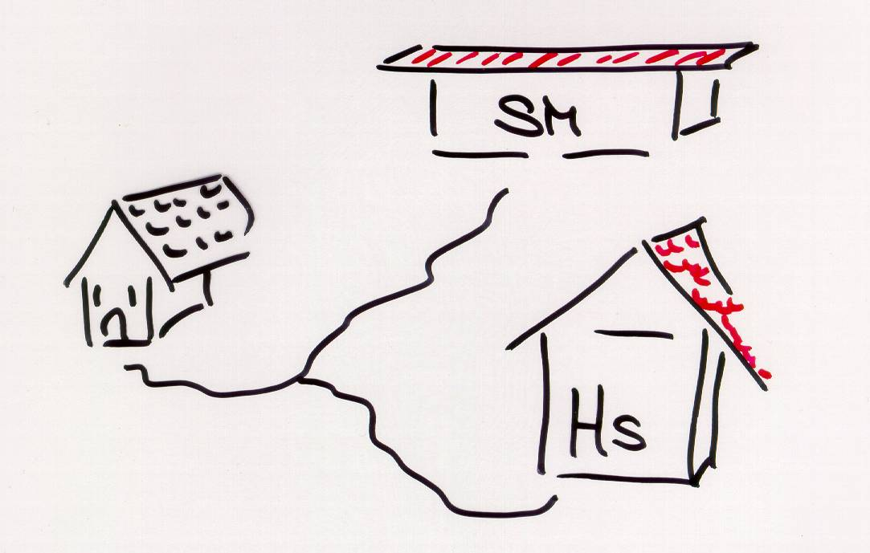
Another Example
At(Home)
Sells(SM, Banana)
Sells(HS, Drill)
Have(Drill)
Have(Milk)
Have(Banana)
SM: Super Market
HS: Hardware Store

Slide 15
Start
At(s),Sells(s,Drill)
At(s),Sells(s,Milk)
At(s),Sells(s,Bananas)
Buy(Drill)
Buy(Milk)
Buy(bananas)
Have(Drill),Have(Milk),Have(Bananas),At(Home)
Finish
Start
At(HWS),Sells(HWS,Drill)
At(SM),Sells(SM,Milk)
At(SM),Sells(SM,Bananas)
Buy(Drill)
Buy(Milk)
Buy(bananas)
Have(Drill),Have(Milk),Have(Bananas),At(Home)
Finish

Slide 16
Partial Order Planning
Start
At(Home)
Buy(Banana)
Buy(Milk)
Buy(Drill)
Causal links
At(Home)
Have(Banana)
Have(Milk)
Have(Drill)
End

Slide 17
Refining the Plan (1)
NB: all causal links
are also ordering links
Start
At(Home)
Ordering links
At(s)
Sells(s,Banana)
At(s)
Sells(s,Milk)
At(s)
Sells(s,Drill)
Buy(Banana)
Buy(Milk)
Buy(Drill)
Causal links
At(Home)
Have(Banana)
Have(Milk)
Have(Drill)
End

Slide 18
Refining the Plan (2)
NB: all causal links
are also ordering links
Start
At(Home)
At(SM)
Sells(SM,Banana)
At(SM)
Sells(SM,Milk)
At(HWS)
Sells(HWS,Drill)
Buy(Banana)
Buy(Milk)
Buy(Drill)
Causal links
At(Home)
Have(Banana)
Have(Milk)
Have(Drill)
End

Slide 19
Refining the Plan (3)
Start
At(Home)
At(s)
At(s)
Go(SM)
Go(HWS)
At(SM)
Sells(SM,Banana)
At(SM)
Sells(SM,Milk)
At(HWS)
Sells(HWS,Drill)
Buy(Banana)
Buy(Milk)
Buy(Drill)
At(Home)
Have(Banana)
Have(Milk)
Have(Drill)
End

Slide 20
Refining the Plan (4)
Start
At(Home)
At(Home)
At(Home)
Go(SM)
Go(HWS)
At(SM)
Sells(SM,Banana)
At(SM)
Sells(SM,Milk)
At(HWS)
Sells(HWS,Drill)
Buy(Banana)
Buy(Milk)
Buy(Drill)
At(Home)
Have(Banana)
Have(Milk)
Have(Drill)
End

Slide 21
Threats to Causal Links
Start
At(Home)
At(Home)
At(Home)
Go(SM)
Go(HWS)
At(SM)
Sells(SM,Banana)
At(SM)
Sells(SM,Milk)
At(HWS)
Sells(HWS,Drill)
Buy(Banana)
Buy(Milk)
Buy(Drill)
At(Home)
Have(Banana)
Have(Milk)
Have(Drill)
End

Slide 22
Threats to Causal Links: Demotion
Start
At(Home)
At(HWS)
At(Home)
Go(SM)
Go(HWS)
At(SM)
Sells(SM,Banana)
At(SM)
Sells(SM,Milk)
At(HWS)
Sells(HWS,Drill)
Buy(Banana)
Buy(Milk)
Buy(Drill)
At(SM)
At(Home)
Have(Banana)
Have(Milk)
Have(Drill)
Go(Home)
End

